Slide 1

Object-Oriented Programming and Data Abstraction Lesson 3: Interfaces
Sections 3.1 – 3.3
Notes:
Replace this with your course title and your name/contact details.

Slide 2
Interfaces

Slide 3
What is an interface?
An interface is a mechanism for spelling out a contract between two parties: the supplier of a service and the classes that want their objects to be usable with the service.
I want to make a new Java class for 3D photos. I need to make sure they are as viewable as 2D photos.
I want to make a new Java class, Seminar, to section tally for enrollment. I need to make sure they can be added and dropped just like regular classes.
I am designing a system for different types of charities. I need to make sure that all charities can accept donations.
In other words, I as a system designer, want to enforce certain behaviors for a group of related classes.

Slide 4
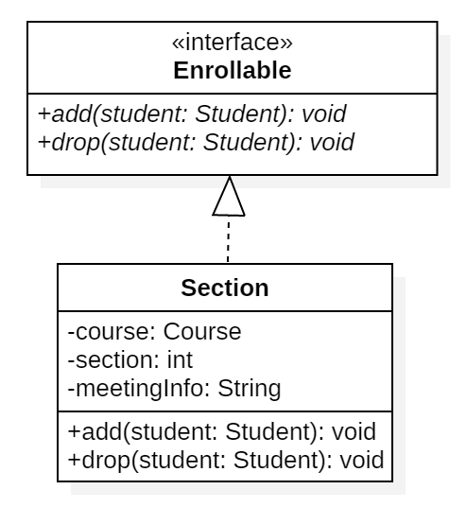
Section Tally Example: Declaring an Interface
We know that sections are enrollable, so we could declare an interface to enforce behaviors of adding and dropping.
public interface Enrollable {
public void add(Student student);
public void drop(Student student);
}
Notice that these methods are headers only; there is no method body.
We call such methods abstract.
Then classes who need such behavior, like Section, could implement this interface.
public class Section implements Enrollable { }
The only problem is, that there is not a body for add() or drop() The Section class must implement these methods by providing the method bodies.
See http://jackmyers.info/oopda/src/Lesson-03/enrollable

Slide 5
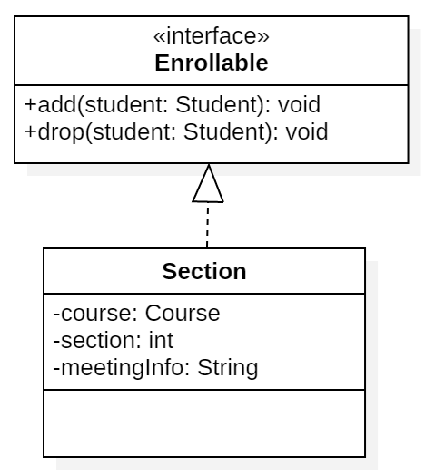
Section Tally Example: From abstract to default methods
An interface can provide a default implementation of a method.
public interface Enrollable {
public default void add(Student student) {
logger.log(Level.INFO, student.getName() + " enrolled in " + this);
EnrollmentManager.enroll(this, student);
}
Now the method add() has a body. We could also add the method code to drop(). We call such methods concrete.
An instance of Section can still invoke the add() method, which will run the default method body
from
to
In UML, abstract methods are in italics

Slide 6
However, default methods can be overridden (1)
If a class implements an Interface and does not like a default implementation, that class can override the method.
public class Section implements Enrollable {
@Override
public void add(Student student) {
// You don't HAVE to use the default method body
// You can add your own code here
...
}
The method signature is comprised of:
The method name
The method parameters including data types and order
To override a method, the replacement method must have the same method signature and the return type must be "covariant".
Covariant means that the return type must be of the same type or of a more specific type. (More on this later.)
By contrast, method overloading is when there are multiple versions with the same name but different parameters. (A different method signature)
Overloading by Type (parameter list has different types)
Overloading by Arity (parameter list has different number of parameters)

Slide 7
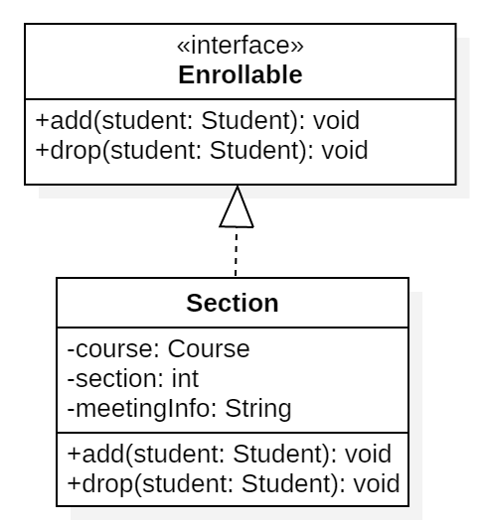
However, default methods can be overridden (2)
If a class implements an Interface and does not like a default implementation, that class can override the method
public class Section implements Enrollable {
@Override
public void add(Student student) {
// You don't HAVE to use the default method body
// You can add your own code here
...
}
Option 1
abstract methods in interface; concrete methods in class
Option 2
default concrete methods in interface; no methods in class
Option 3
default concrete methods in interface; overridden concrete methods in class

Slide 8
Sometimes you like the default implementation, but…
…you want to add a little extra.
You can still call the default method from the interface even if you have overridden it.
@Override
public void add(Student student) {
Enrollable.super.add(student); // You can call the default method!
EnrollmentManager.emailSpeaker(this, student); // and add extra code
}
Syntax
First specify the interface Enrollable
Next use the keyword super Enrollable.super
Then call the method Enrollable.super.add()
You have to specify the interface because, as you will see, a class can implement multiple interfaces.
The @Override message is optional, but it helps the compiler, ensures the method is actually overriding another, and makes your code more readable

Slide 9
Declaring objects of an interface type
You are very used to declaring and initializing variables using their class.
Course oopda = new Course("OOPDA", "This course teaches advaned Java.");
Section oopda01 = new Section(oopda, 1, "MW 17:00 Robinson 325");
But did you know you could declare a variable as its interface?
List<String> list =
new ArrayList<String>(List.of("Peter", "Paul", "Mary"));
Enrollable oopda01 = new Section(oopda, 1, "MW 17:00 Robinson 325");
You can always assign an object to a variable whose type is an implemented interface, or pass it to a method expecting such an interface.
However you can never make an instance of an interface.
Enrollable oopda01 = new Enrollable(oopda, 1, "MW 17:00 Robinson 325");
X

Slide 10
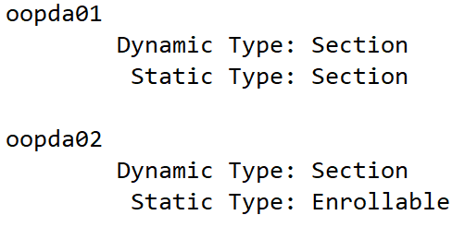
When the declared type is different from the actual type
Consider this code
The static type is how a variable is declared and what the compiler thinks it is.
The dynamic type is what the object really was created as and how it is stored in memory.
private static Course oopda = new Course("OOPDA", "This course teaches advaned Java.");
private static Section oopda01 = new Section(oopda, 1, "MW 17:00 Robinson 325");
private static Enrollable oopda02 = new Section(oopda, 1, "MW 12:30 Robinson 312");
Static types
Dynamic types

Slide 11
Casting and instanceof

Slide 12

instanceof
A type S is a supertype of the type T (the subtype) when any value of the subtype can be assigned to a variable of the supertype without a conversion.
For example, the Enrollable interface is a supertype of the Section class
A Section "is-a" Enrollable
The instanceof operator will check for both static and dynamic types
private static Enrollable oopda02 = new Section(oopda, 1, "MW 12:30 Robinson 312");
is-a
System.out.println(oopda02 instanceof Section);
System.out.println(oopda02 instanceof Enrollable);

Slide 13


The compiler deals only in static types
However, there could be a problem when the declared type (static type) is a supertype.
private static Course oopda = new Course("OOPDA", "This course teaches advaned Java.");
private static Section oopda01 = new Section(oopda, 1, "MW 17:00 Robinson 325");
private static Enrollable oopda02 = new Section(oopda, 1, "MW 12:30 Robinson 312");
compilation errors
The compiler knows oopda01 is a Section, so it is okay with using one of Section's getter methods.
The compiler knows oopda02 is a Enrollable, so it has no idea that getMeetingInfo() is a valid method.
The compiler knows oopda01 is a Section which implements Enrollable, so it recognizes method add() from the Enrollable interface.
The compiler knows oopda02 is a Enrollable, so it recognizes the method add() from the Enrollable interface.

Slide 14
casting
If you are certain of the dynamic type of an object, you can cast it. So the compiler will take your word for it.
It is a good idea to make an instanceof check before using a cast.
private static Course oopda = new Course("OOPDA", "This course teaches advaned Java.");
private static Section oopda01 = new Section(oopda, 1, "MW 17:00 Robinson 325");
private static Enrollable oopda02 = new Section(oopda, 1, "MW 12:30 Robinson 312");
This time, we first cast oopda02 as a Section before calling the getMeetingInfo() method. Now the compiler is okay with using one of Section's getter methods because you have told it to treat oopda02 as a Section.

Slide 15
More about interfaces

Slide 16
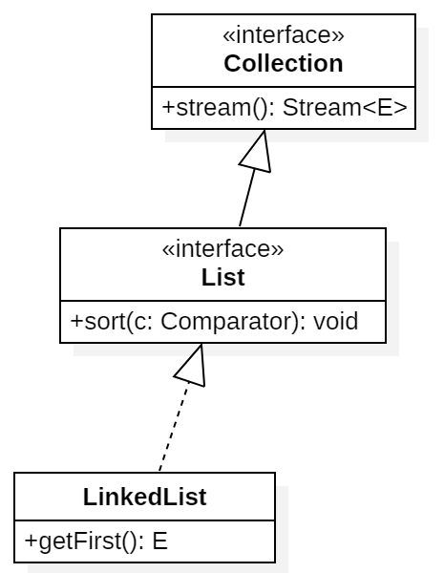
Extending Interfaces
An interface can extend another, requiring or providing additional methods on top of the original ones.
For example, Closeable is an interface with a single method:
public interface Closeable {
void close();
}
The Channel interface extends this interface:
public interface Channel extends Closeable {
boolean isOpen();
}
Therefore, a class that implements the interface Channel will have defined methods from both interfaces.
LinkedList has a getFirst() method of its own, but picks up sort() from its interface List which, in turn, picks up stream() because List extends Collection.
extends
implements

Slide 17
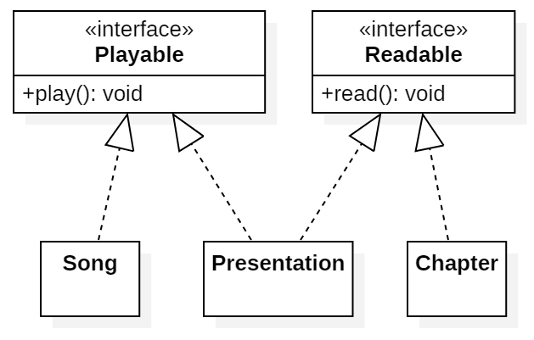
Multiple Interfaces
You can implement more than one interface.
For example,
a Song might be playable
a Chapter might be readable
a Presentation (think narrated PowerPoint) might be both readable and playable

Slide 18
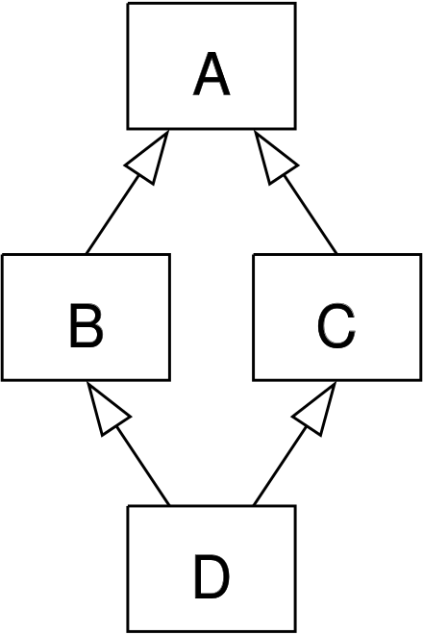
The Diamond Problem
AKA “The Diamond of Death”
Imagine we have an interface A with an abstract someMethod()
Interfaces B & C both extend A and provide a default implementation for someMethod()
Class D combines the functionality of B & C by implementing both but does not override someMethod()
If D doesn't provide a method body, which implementation of someMethod() should D inherit?
java: class D inherits unrelated defaults for someMethod() from types B and C
D needs to provide a method body for someMethod()
interface
extends
extends
interface
interface
implements
Notes:
There is no clear answer here. So java prior to 1.8 did not under any circumstances allow multiple inheritance of implementation

Slide 19
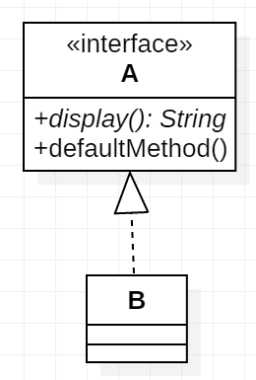
Drawing Interfaces in StarUML
Interfaces and Interface Realizations
from the Format menu:
For StarUML interfaces, you need to stop Suppressing operations
And the stereotype display needs to be set to Label

Slide 20
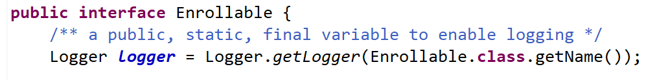
Constants
Any variable defined in an interface is automatically public static final.
For instance, here is a Logger in interface Enrollable

Slide 21
Types of Methods in Interfaces

Slide 22
There are four types of methods that can be placed into an interface
We've seen two of them – abstract and default
Type of Method | Characteristics | Notes
Abstract | Method has only a header | Concrete classes implementing the interface need to provide a body
Default | Method has a body and the default keyword | Classes implementing the method will use the default code, unless they override it.
Static | Method is at the interface level | You don't need to make an instance of a class implementing the interface in order to to run the method.
Private | "Helper" methods for other interface methods. | Can be either static or instance level. Cannot be default, as no impelemting class can see them. Added in Java 9

Slide 23
Rules for Private Methods in Interfaces
Using private methods in interfaces have four rules :
Private interface method cannot be abstract.
Private method can be used only inside interface.
Private static method can be used inside other static and non-static interface methods.
Private non-static methods cannot be used inside private static methods.
public interface Analyzable {
default HashSet<String> processText(String value) {
// Parse the string into words using a RegExp of delimiters
String[] tokens = removeTags(value).split("[\n\t\r (),.:;+]");
HashSet<String> uniqueWords = new HashSet<>();
...
}
private String removeTags(String value) {
return value.replaceAll("\\<.*?\\>", "");
}
An example of a private method
This private "helper" method will remove HTML tags, e.g., <p> from a String

Slide 24
Examples of Interfaces

Slide 25
Comparable
Consider sorting an array of objects.
A sorting algorithm repeatedly compares elements and rearranges them if they are out of order. But what is "the order"? (How would we sort Persons?)
The sorting algorithm should just call a method supplied by the class.
BUT, the algorithm cannot possibly guess what the method name and signatures are for every sortable class!!
Solution?
Have every "sortable" class implement the interface Comparable
This will mandate the implementation of the compareTo() method.
We want to compare strings against strings, employees against employees, and so on. For that reason, the Comparable interface has a type parameter.

Slide 26
Many classes* implement the Comparable interface
Such as Integer, Double, LocalDate and String
The compareTo() method can return one of three values.
A negative number if the current object comes before the object compared to.
A positive number if the current object comes after the object compared to.
Zero if the two objects are equal.
The magnitudes of the positive /negative numbers returned have no significance.
If two elements are equal as defined by the object's equals() method, then compareTo() should return zero. (This rule is a should, not a must.)
See BookCompare, DateCompare and TaskCompare examples at http://jackmyers.info/oopda/src/Lesson-01/advancedCollections/

Slide 27
compareTo() warning when using Sets
The compareTo() method can return one of three values.
A negative number if the current object comes before the object compared to.
A positive number if the current object comes after the object compared to.
Zero if the two objects are equal.
If two objects are equal, they cannot both exist in a Set!
Hence if you think your objects will be used in sets, make sure your compareTo() method does not falsely identify duplicate values
Or else use the interface Comparator instead of Comparable (see Chapter )

Slide 28
Implementing your own compareTo()
the Comparable interface has a type parameter
public class Book implements Comparable<Book> {
@Override
public int compareTo(Book b) {
// Compare alphabetically by title, then by author
int compare = this.title.compareTo(b.getTitle());
if (compare != 0) {
// The books have different String titles
return compare;
}
else {
// Let's compare by author
compare = this.author.compareTo(b.getAuthor());
return compare;
}
}

Slide 29
Check out other common interfaces in the textbook
Comparator interface
You cannot have two compareTo() methods in the same class, so Comparators are a way to enable multiple sorting options.
Runnable interface
Allows tasks to be run in multiple threads for parallel processing
EventHandler interface
Which we will eventually use in JavaFX GUIs.

Slide 30
Summary

Slide 31
Interfaces: Design for the Future
In our Section Tally example, we made an ArrayList of Enrollables, not Sections
private static List<Enrollable> classes = new ArrayList<Enrollable>();
Since Sections were Enrollable, we could add Sections to the list.
Section oopda01 = new Section(oopda, 1, "MW 17:00 Robinson 325"); classes.add(oopda01);
When we wanted to add a new class Seminar, we could make it implement Enrollable as well. And therefore add it to our ArrayList of Enrollables
Speaker emil = new Speaker("Emil Eifrem", "emil@neo4j.com"); LocalDateTime time = LocalDateTime.of(2021, 12, 17, 11, 0); classes.add(new Seminar("Using Neo4j", time, "Tohill", emil));
And we could ensure that all Sections and Enrollables had to implement certain behaviors, like:
add(), drop(), getDetails()
Therefore, we could loop through the collection and be guaranteed that the methods (behaviors) would be there!
classes.forEach(e -> System.out.println(e.getDetails()));

Slide 32
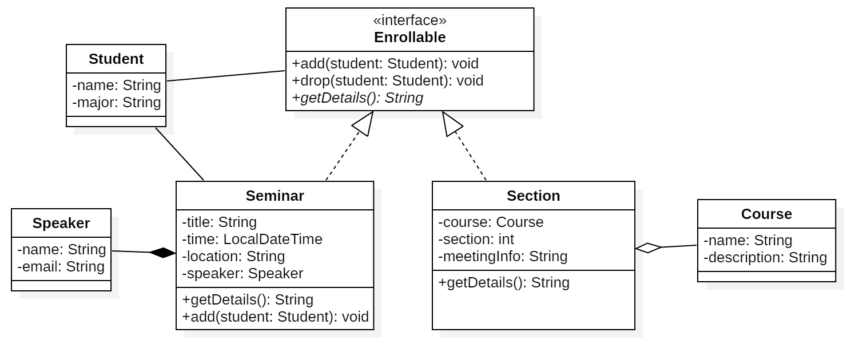
Final Version of Enrollment

Slide 33
Interfaces Can Contain (a handy reference slide)
An interface can contain six different things:
Constant variables
Abstract methods
Default methods
Static methods
Private Static Private methods
methods

Slide 34
In summary
An interface specifies a set of methods that an implementing class must provide.
An interface is a supertype of any class that implements it. Therefore, one can assign instances of the class to variables of the interface type.
An interface can contain static methods.
All variables of an interface are automatically public, static, and final.
An interface can contain default methods that an implementing class can inherit or override.
An interface can contain private methods that cannot be called or overridden by implementing classes.
The Comparable and Comparator interfaces are used for comparing objects.

